Slide 1
Wood Identification
Andrew Stevens
GWW, Tuesday 11 March 2014

Slide 2
What is wood?
Wood consists of two main ‘ingredients’
Fibres made of cellulose (70%), which resist tension,
Lignin (25%), which resists compression
Wood performs two functions
Support for the tree
Transport for water from roots and nutrients from leaves to growth areas
Some facts:
Earth contains 10 trillion tonnes of wood. It is probably the most important renewable resource we have
Trees are the largest and oldest living organisms
Tallest: Coast Redwood (Sequoia sempervirens): 115.72 m
Largest: Giant Sequoia (Sequoiadendron giganteum): 1,487 m³
Fattest: Montezuma Cypress (Taxodium mucronatum): 11.62 m

Slide 3
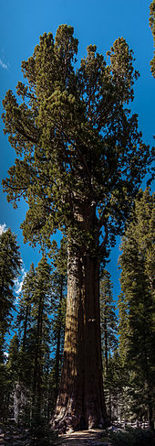
The General Sherman
The General Sherman is a giant sequoia located in the Sequoia National Park in California.
By volume, it is the largest known living single stem tree on Earth.
The General Sherman Tree is neither the tallest known living tree on Earth nor is it the widest (both the largest cypress and largest baobab have a greater diameter), nor is it the oldest known living tree on Earth (that distinction belongs to a Great Basin bristlecone pine).
With a height of 83.8 metres (275 ft), a diameter of 7.7 metres (25 ft), an estimated bole volume of 1,487 cubic metres (52,513 cu ft), and an estimated age of 2,300–2,700 years it is nevertheless among the tallest, widest and longest-lived of all trees on the planet.
Source: Wikipedia

Slide 4
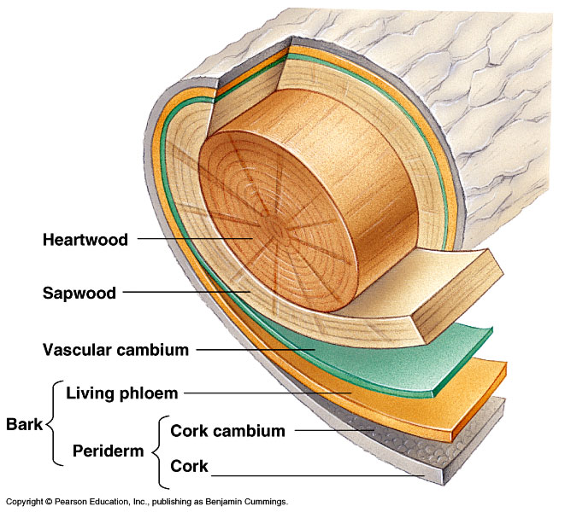
How does wood grow?

Slide 5
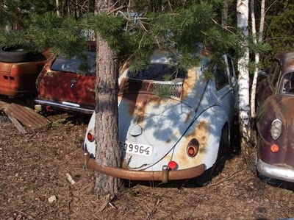
I told you not to park there..

Slide 6
Classification of Wood
Problems with the ‘common sense’ words and labels …
Softwood vs Hardwood
In general, this is useful way to classify timber, but the softest wood known is Balsa, classified a hardwood and a very hard wood, Yew is classified a softwood
Evergreen vs Deciduous
Again this is generally true, although some ‘evergreen’ trees lose their leaves (swamp cypress) and ‘deciduous’ trees retain theirs (Holly, holm oak etc). Also few subtropical trees lose their leaves, despite being ‘deciduous’.
Needle–like leaves vs Broad leaves
Again, some softwoods do not have classic needle-like leaves (ginkgo, cypress, yellowwood) and some plants with needle-like leaves are formally classified amongst the deciduous…

Slide 7
Classification of Wood
In the end we resort to science, which has produced the following labels, Gymnosperm & Angiosperm
Gymnosperm means ‘naked seed’ and these were the earliest trees to evolve. They do not produce flowers and have seeds which are directly exposed to the air for wind pollination. Pine cones are one example. For ease you might think of the gymnosperms as conifers, such as yew and Scots pine.
Angiosperm means ‘hidden seed’ and these are typically flowering trees which have seeds hidden inside a fruit. These trees evolved alongside insects, birds and mammals and usually make use of them for pollination. The angiosperms can be thought of as hardwoods, such as oak and beech.

Slide 8
Factors influencing wood identification
Is it solid or man made?
Colour
  Natural or stained
  New or aged
Weight and Hardness
What was the source?
  Import or local
  Industrial (e.g. palette, lumber or furniture)
Smell
  Resinous, scented, dusty…

Slide 9
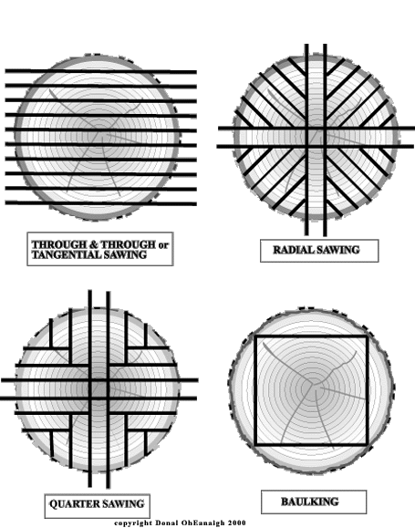
Factors influencing wood identification
Figure (Grain pattern)
  Open (porous) or smooth
  Differentiation between heartwood and sapwood?
  How was it converted from tree?

Slide 10
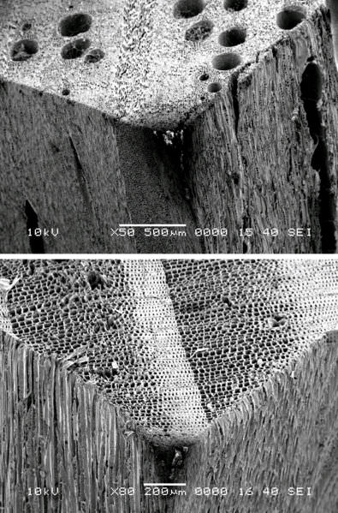
Finally…
Look at the endgrain with a 10x magnifier
Hardwoods have open pores while softwoods have no open pores
Each wood has its own distinctive pattern
This is how the experts do it! But this is a topic for another day…

Slide 11
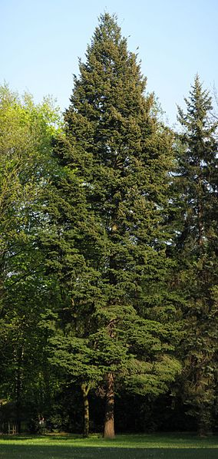
Thank you!
Any guesses?
Pseudotsuga Menziesii
Douglas Fir
Oregon Pine

